Slide 1

Identification of Combinations of Targets for Reversion of Tumorigenesis in Claudin-Low Triple Negative Breast Cancer
Madeleine S. Gastonguay
Advisor: Paola Vera-Licona, PhD
Computational Systems Medicine Research Group
Center for Quantitative Medicine
CCAM Summer Research Presentation
7/26/2019

Slide 2

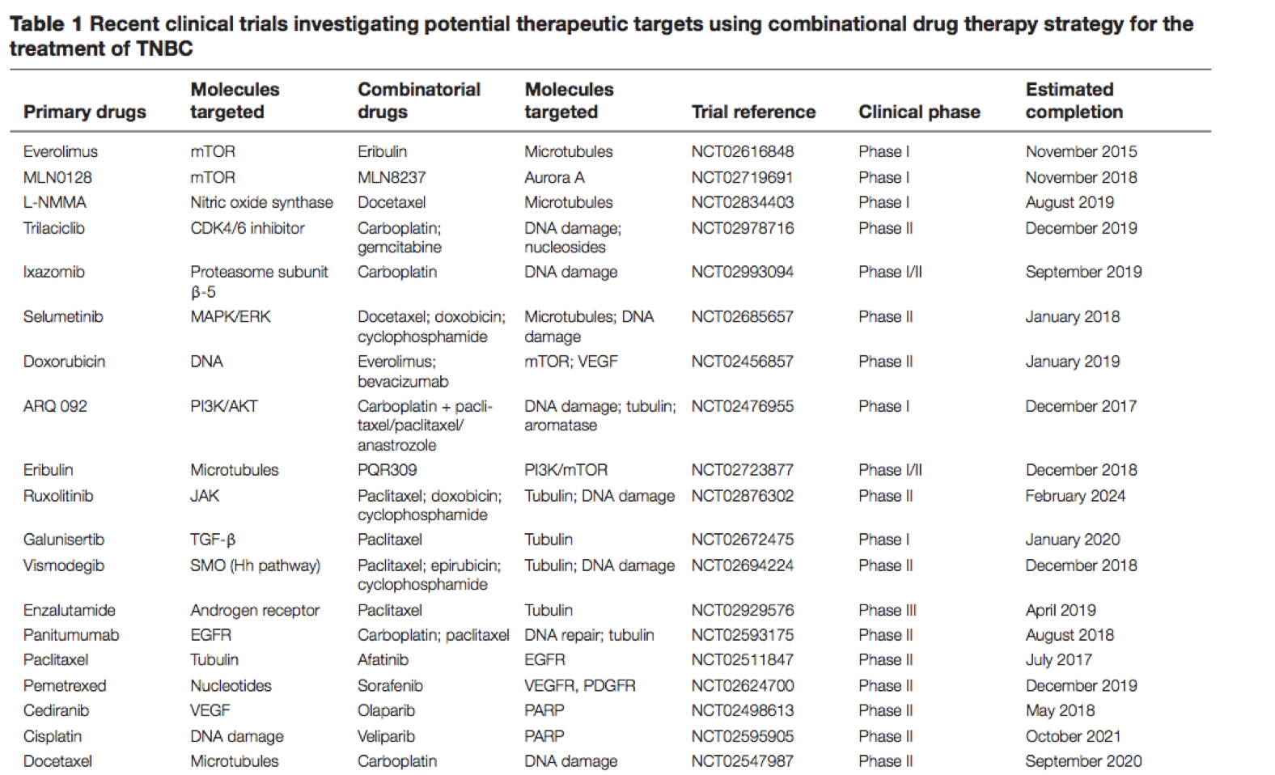
80%
Motivation
Triple Negative Breast Cancer
Highly aggressive, difficult to treat breast cancer subtype
Poor prognosis
OBJECTIVE: Use a systematic approach to identify combinations of therapeutic targets for Claudin-Low Triple Negative Breast Cancer
Of clinical trials studying TNBC therapeutics are investigating target combinations [5]
Claudin-Low Triple Negative Breast Cancer (CL TNBC)
7-14% of invasive breast cancers [1]
Low expression of Claudins and E-Cadherin [1,2,3]
Prone to epithelial to mesenchymal transition (EMT) and stemness [1,4]
Low proliferation rate [1]
1. Dias, PloS one 2017
2. Prat, Breast Cancer Research, BioMed Central, 2010
3. Holliday, Breast Cancer Research, BioMed Central, 2011
4. Salvador, Currentpathobiology reports, 2016
5. Chalakur-Ramireddy, Biosci, 2018
Celgene
Notes:
TNBC is an aggressive subtype of breast cancer classified by the lack of estrogen, progesterone, and HER2 receptors. This, coupled with Its invasiveness and metastatic tendencies, make TNBC difficult to treat and leads to a poor prognosis.
Claudin low TNBC is a subtype of TNBC accounting for 7-14% of invasive breast cancers. It’s characterized by low expression of tight junction proteins Claudin 3,4, and 7 and the cell adhesion molecule E-cadherin. Furthermore, CL tumors are prone to undergoing the epithelial to mesenchymal transition as well as exhibiting stem-cell like characteristics, and low proliferation rates. These are all hallmarks of cancer which leads to a high rate of metastasis and low efficiency of cytotoxic drugs.
Although chemotherapy, targeted therapies, and immunotherapy may not be effective on their own, many clinical studies are currently testing combinations of targets as new therapeutic strategies. This project aims to provide a systematic approach to identify in silico those target combinations that can revert a claudin low TNBC tumor to a normal one.

Slide 3
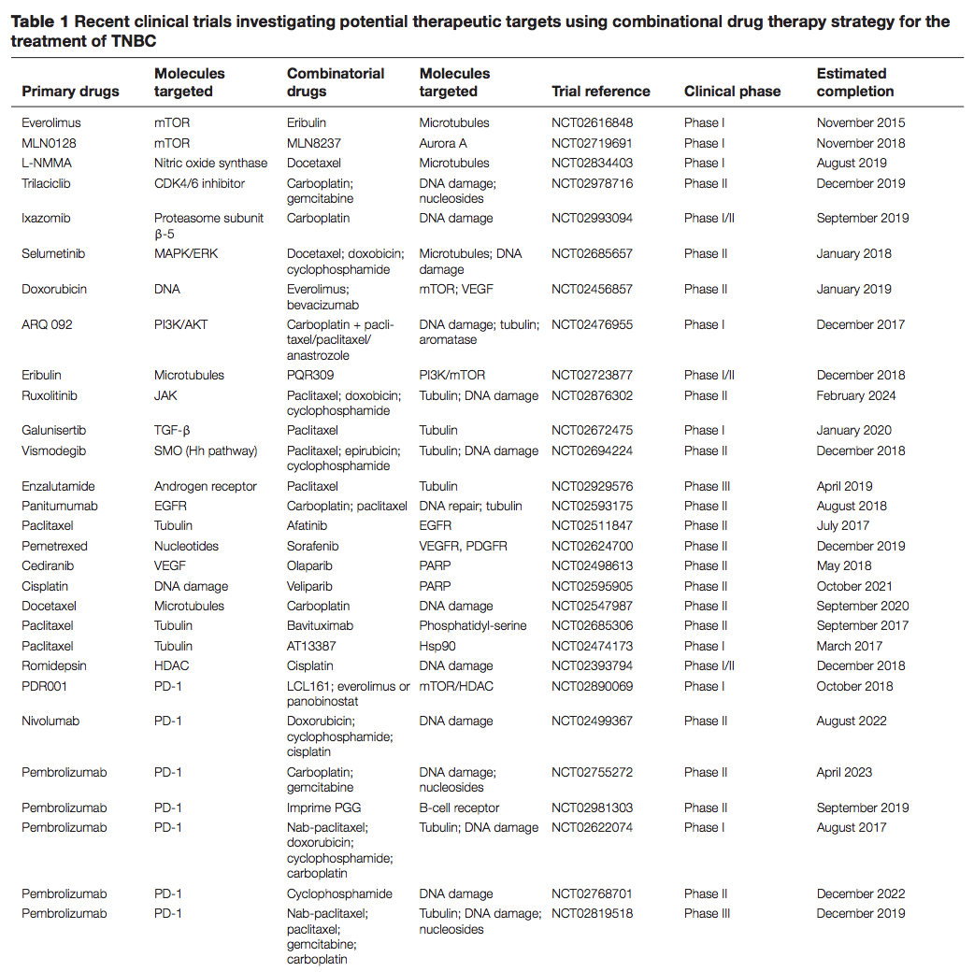
80%
Of clinical trials studying TNBC therapeutics are investigating target combinations
OBJECTIVE: Use a systematic approach to identify combinations of therapeutic targets for Claudin-Low Triple Negative Breast Cancer

Slide 4
Tumor Reversion
Background
The biological process by which tumorigenic cells lose a significant fraction of their malignant phenotype [1]
Least commonly explored therapeutic approach
Claudin-low tumors have been reverted both in vivo and in vitro with the cell line MDA-MB-231 [2, 3, 4, 5, 6, 7]
1. Telerman, Nat. Rev. Cancer, 2009
2. Chu, PLoS One, 2013
3. Chu, Oncogene, 2012
4. Yan, J. Biol. Chem, 2010
5. Dydensborg, Oncogene, 2009
6. Kong, Mol. Syst. Biol, 2014
7. Matossian, Oncoscience, 2018
Notes:
Cancer reversion is the biological process by which tumorigenic cells lose a significant fraction of their malignant phenotype. Cancer reversion has been observed experimentally throught the past century. In particular, the claudin-low breast cancer cell line MDA-MB-231 and claudin low tumors in vivo have been reverted. However, very little work has been done to explore this idea quantitatively, so we want to take a dynamical systems approach to identify combinations of tumor reversion targets.
So, we aim to take a dynamical systems modeling approach to identify the targets which will prompt tumor reversion in the claudin-low cell line, MDA-MB-231.
The idea that cancer reversion can be modeled in this way is based on Waddington’s epigenetic landscape from the 1950s. In his depiction, he related differentiation of a cell to a ball rolling down a slanted “landscape” to a point of lowest elevation- a basin or a valley- which would represent a stable cell phenotype. In the 70’s, Kauffman mathematically proved that this landscape is a high-dimensional state space in which a cell’s long-term behavior, or attractor, can be associated to a cell’s phenotype, shaped by the architecture and dynamics of its regulatory network.
Kauffman also established the idea of a cancer attractor states. These are hidden stable states that are not commonly occupied by normal cells, but can be accessed by genetic events such as mutations or contextual signals in the tumor microenvironment.
Therefore, we can use this concept to transition a cancerous cell to a normal one by changing its steady state. In the terms of the landscape, a switch between these phenotypes would be represented by the transition of a cell between two valleys. Targeting the drivers to shift the cells from tumorigenic to non-tumorigeneic attractors can reverse the development of breast cancer.
The identification of these driving factors could result in improved clinical outcomes in TNBC
Removed:
Cells seek the lowest reachable (= most probable = stable) states (= attractors).

Slide 5
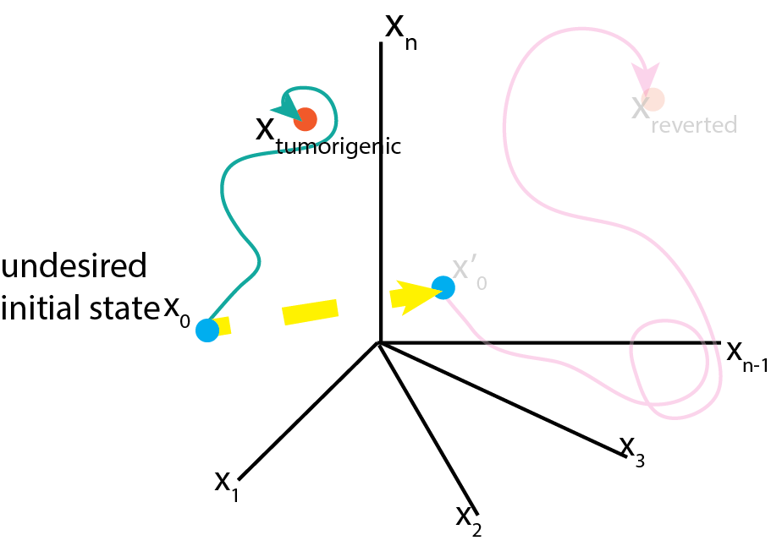
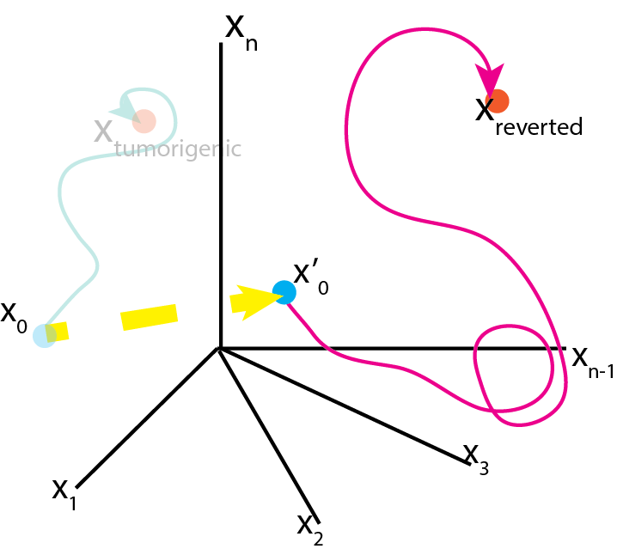
Tumor Reversion
Dynamical Systems Theory
Attractors of gene regulatory networks correspond to cell phenotypes
Cancer attractors: attractors presenting a malignant phenotype that are pre-existing in the network but not typically accessible and therefore not occupied
Can be accessed by genetic mutations or changes in the microenvironment
A concerted perturbation of multiple network nodes can transition the network state away from a tumorigenic attractor and towards a normal attractor, effectively switching the phenotype of the cell from tumorigenic to normal
Huang, Ernberg, and Kauffman, Seminars in Cell & Developmental Biology, 2009
Notes:
To apply this to cancer reversion …

Slide 6
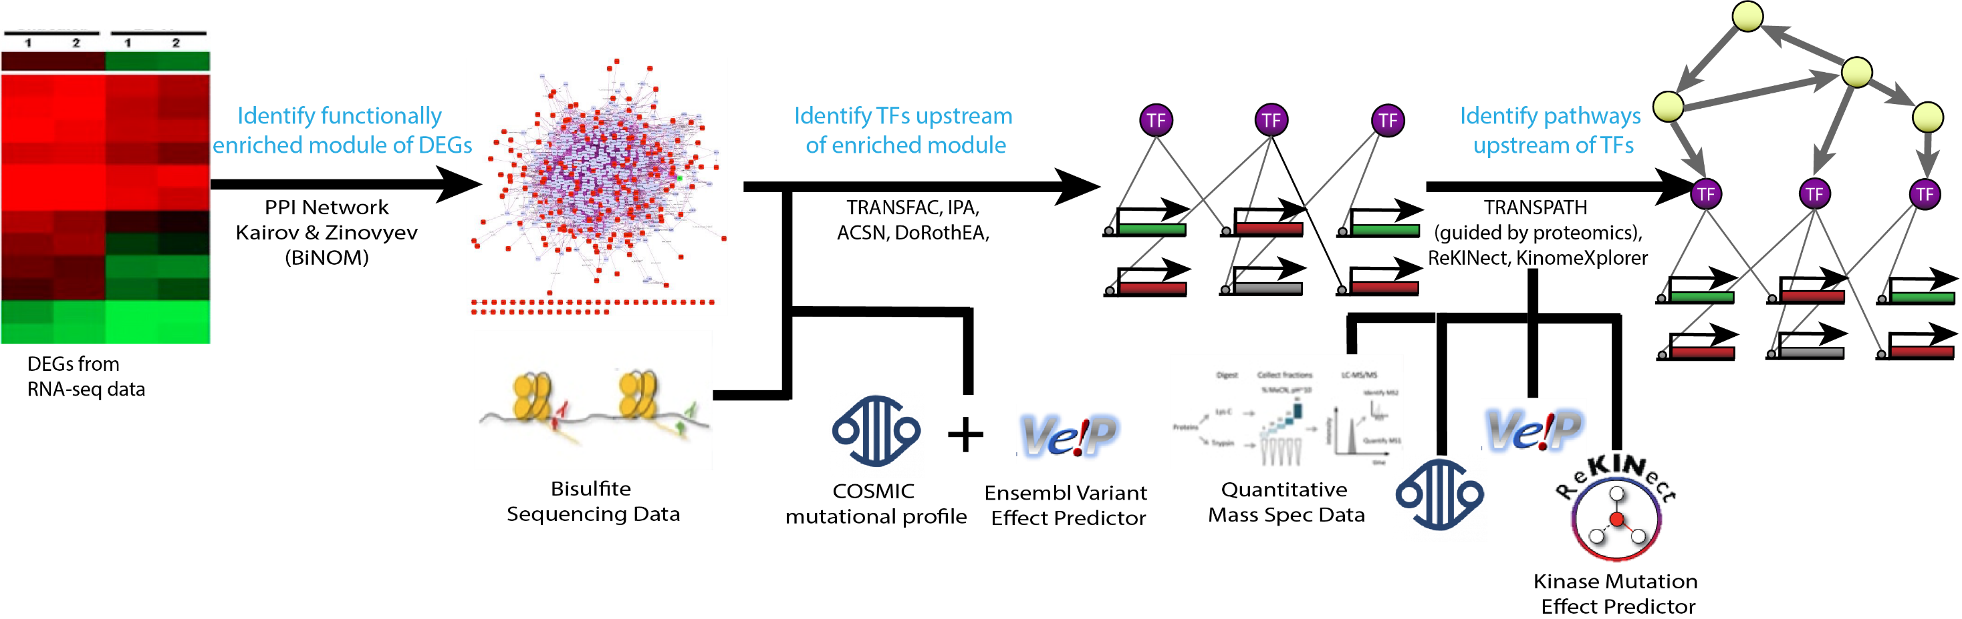
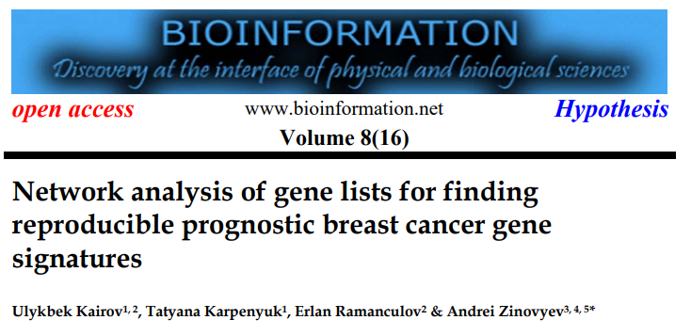
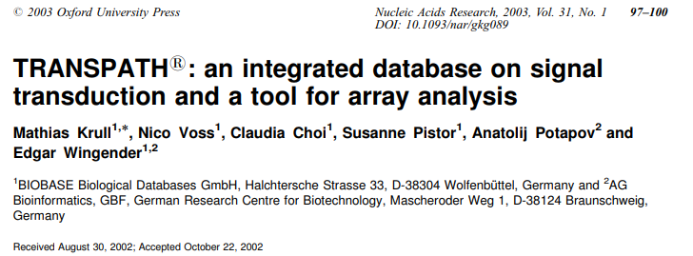
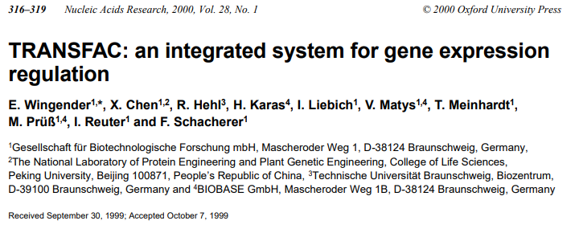
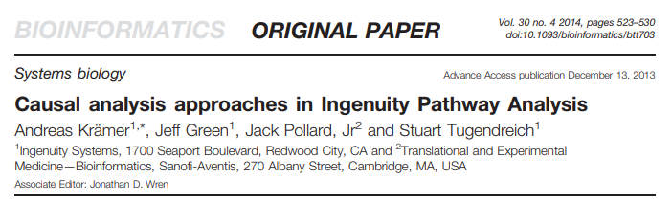
Construction of Intracellular Signaling Network
With the Use of Multi-omics Data
CL TNBC MDA-MB-231 vs Normal MCF10A

Slide 7
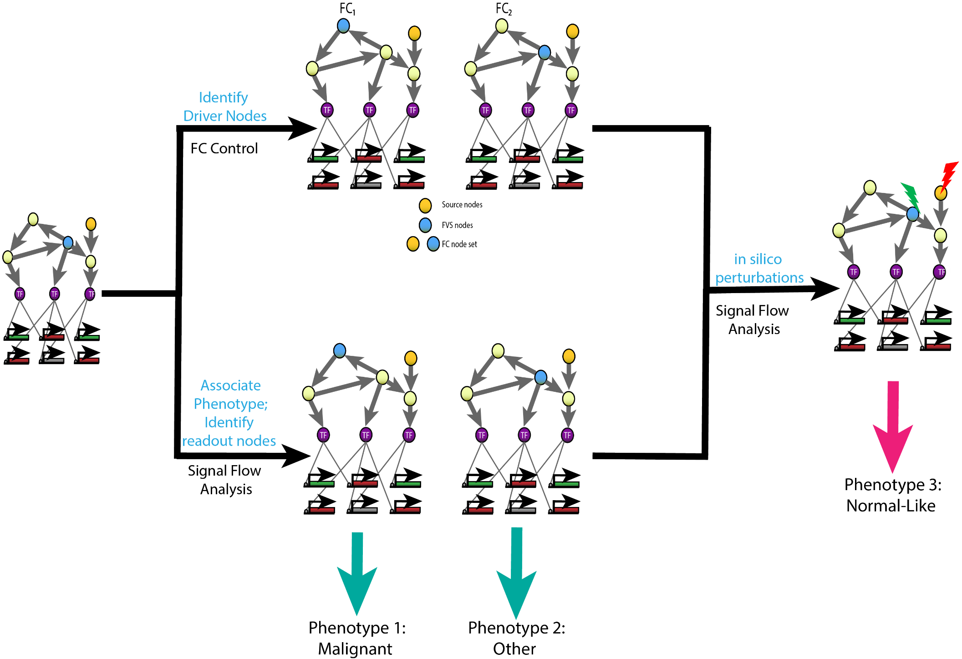
Network Analysis
Notes:
After constructing the network, we used structure based control methods to identify reversion targets.
Feedback Vertex Set (FVS) Control methods use the structure of the network to identify driver nodes for attractors. In most signaling networks, there are feedback loops (for example: positive or negative inhibition), which then make the system non-linear. The FVS is a minimal set of vertices (nodes) whose removal from a network would leave no cycles (no feedback loops). The FVS set combined with the source nodes of the network constitutes the feedback vertex set control set, or FC set, which can steer the system from Any observable phenotype to any other observable phenotype.
Next, we ran signal flow analysis to estimate the attractors of the network.
Because we don’t have a dynamic model to quantitatively characterize the attractor landscape, we performed a topological estimation of signal flow from the different initial conditions to estimate the attractors of the network. For example, we useed the initial conditions from our experimental data for MDA-MB-231 to run signal flow and estimate the cancerous attractor. This process will be repeated with a large number of randomly generated initial conditions to estimate the attractor landscape of the network.
To reduce the number of nodes that must be controlled to drive the state of the network, we will use our tool OCSANA. This will dentify nodes that can canalize the signal from the FC nodes that are source nodes to the readout nodes.
Latly, We ran in silico perturbations of the FC set by setting the initial condition for each of the FC nodes to either an activated or inactivated state and running signal flow to estimate the resulting attractor. Perturbations were deemed successful if they created a direction of activity change for the readout nodes in the same direction as the change from the cancerous attractor to the normal attractor, as this indicates a change in expression that is more similar to the normal phenotype than the cancerous one. Those nodes whose perturbation was able to change the resulting attractor to be more “normal – like” are potential reversion targets.
Removed:
These FC nodes are considered Tumor Reversion Driver Nodes.

Slide 8
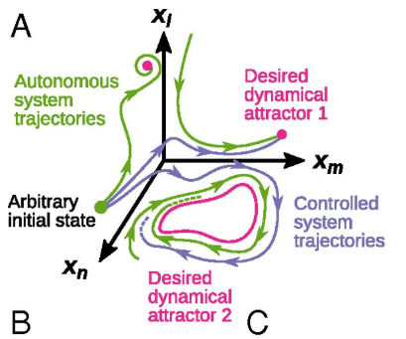
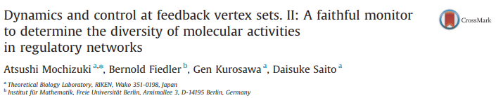
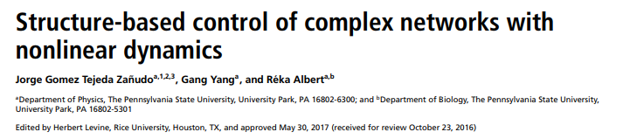
Structure Based Control
Feedback Vertex Set Control (FC)
Notes:
Methods for linear systems but this is for non linear

Slide 9

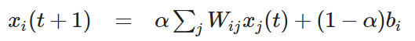
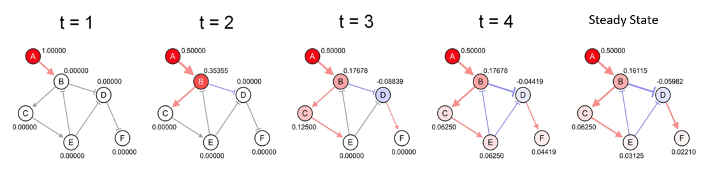
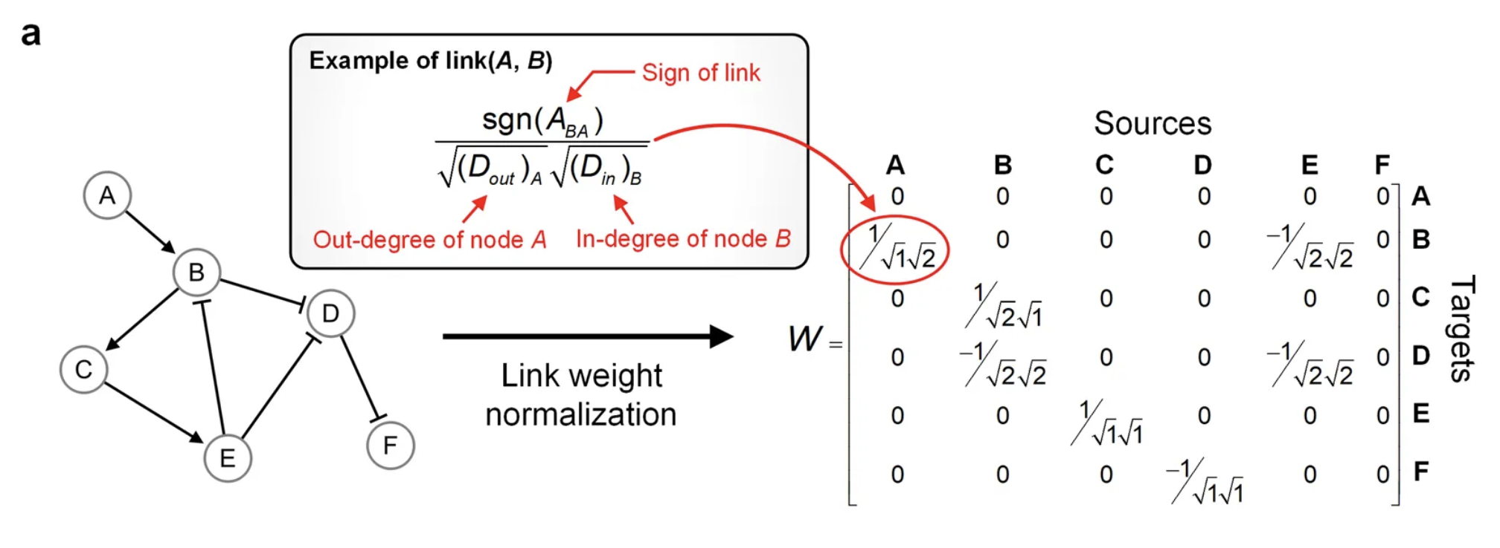
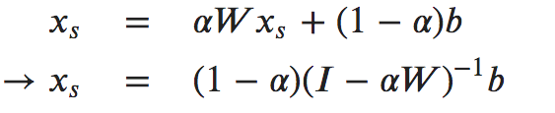
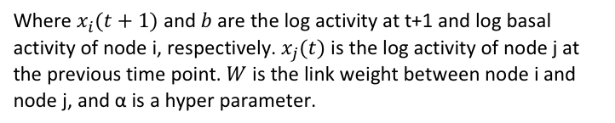
Topological Estimation of Network Attractors
Signal Propagation Algorithm
Where $x_{i}(t+1)$ and $b$are the log activity at t+1 and log basal activity of node i, respectively. $x_{j}(t)$ is the log activity of node j at the previous time point. $W$ is the link weight between node i and node j, and α is a hyper parameter.

Slide 10
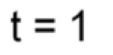
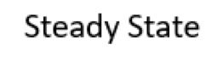
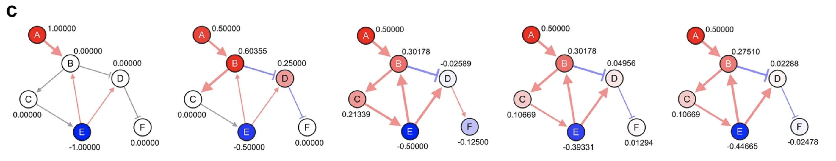
In Silico Screening
Cancerous
Perturbed

Slide 11
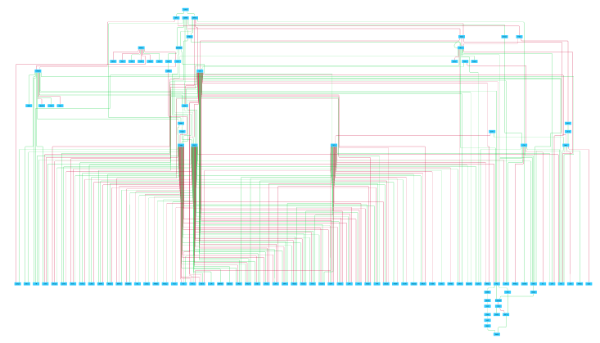
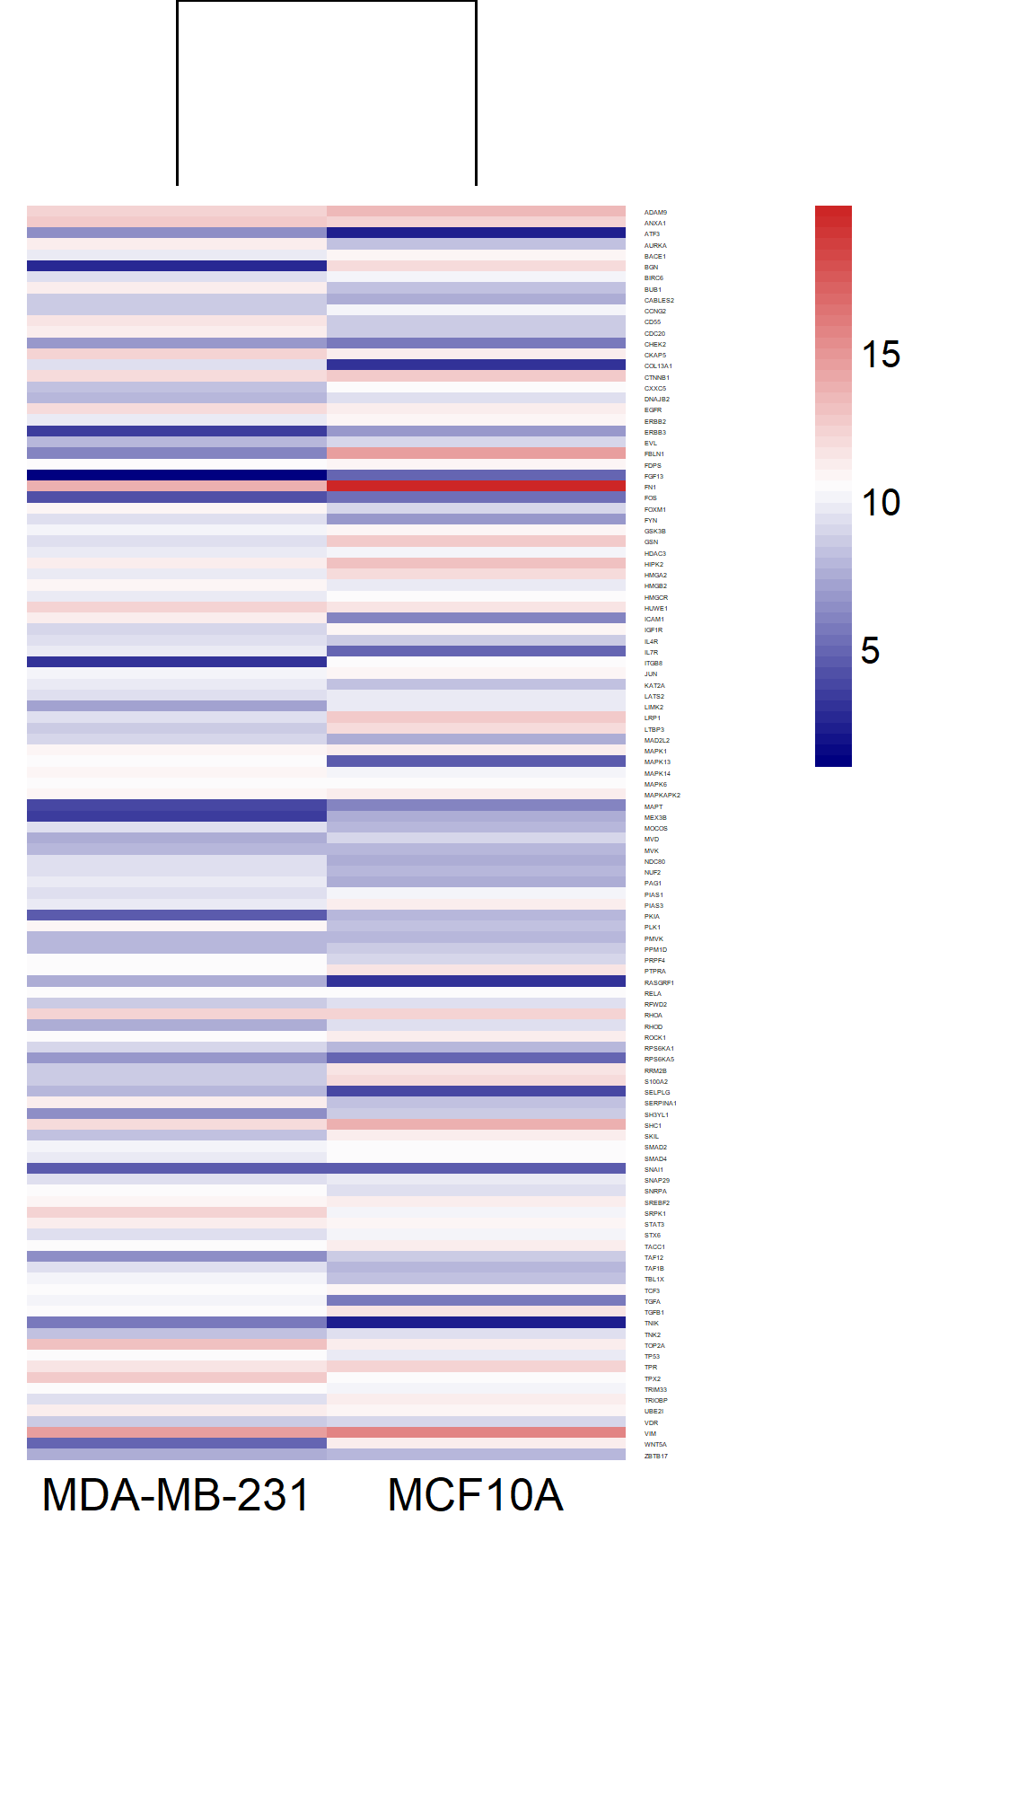
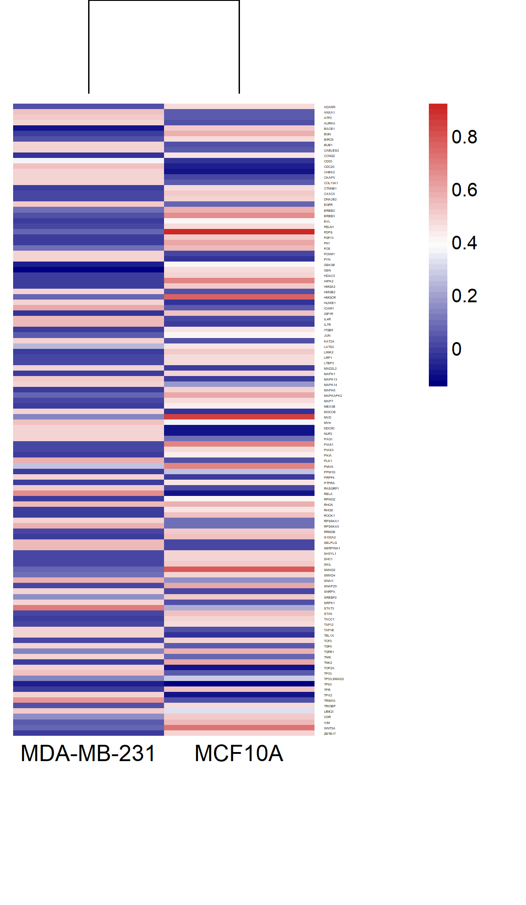
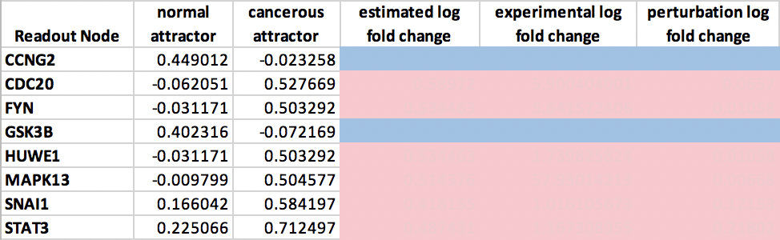
MDA-MB-231 Tumorigenic Intracellular Signaling Network
116 nodes, 259 edges
23 genes related to EMT
4 Claudin-Low related genes
15 breast cancer related genes
8 Readout Nodes
2 FC sets of 8 nodes
In silico perturbations
Inhibition of: EGFR, HDAC3, MAPK6
RNA-seq data
Attractor Values
Notes:
The network has 116 nodes and 259 edges. Several genes related to EMT, CL tumorigenesis, and breast cancer such as TP53, STAT3, VIM, and snail are included in the network. After running structure based control, we identified two different FVS sets, each with 3 nodes. These nodes have previously been identified in vitro as potential therapeutic targets because altering heir expression can increase apoptosis, reduce proliferation, or reverse EMT in tumors.
We estimated the attractors of MDA-MB-231 and MCF10A using signal flow analysis and verified that the steady state activity level for each node is different in across the two attractors, as can be see in the heat map.
The direction of activity change between attractors predicted by signal flow matches that of the experimental log fold change for all nodes in the network but one, providing evidence that SFA is yielding reliable results. We identified 8 readout nodes that are related to EMT, stemness, and proliferation, and have different expression levels in the normal and cancerous attractors. These readout nodes were used to determine the success of our perturbations.
We next ran in silico perturbation analyses on the network, randomly perturbing the FC nodes to either an activated or inactivated state. Out of 6561 perturbations, 152 combinations produced the desired direction of activity change in all 8 readout nodes. I’ve included just one example where EGFR, HDAC3, MAPK1, MAPK6 were inhibited and ZBTB17 was activated and the desired changes in activity were achieved, making these genes potential tumor reversion targets.
Node information:
TNBC tumorigenesis, including ICAM1, ANXA1⁷⁴, and TP53⁷⁵.
43 genes related to EMT and innate immunity (STAT3⁷⁶, SNAI1 SMAD2⁷⁷, RHOA⁷⁸, WNT5A⁷⁹, and members of the Ras/MAPK pathway⁸⁰)
4 Claudin low related genes ("CDC20" "ERBB2" "ERBB3" "VIM" )
15 breast disease ontology genes
Put FVS nodes on slide instead of saying them?
Both sets included EGFR and RELA, but one included FOXM1 while the other had PLK1
Do I need this: The combination of these FVS sets with the 5 source nodes comprises the FC set of 8 nodes which has the potential to drive our network form any phenotype to another.

Slide 12
Conclusions
The pipeline we developed generates a network capturing important aspects of signaling in claudin-low triple negative breast cancer
The use of structure based control methods identified putative targets for claudin-low cancer reversion
Future Directions
Approximate the attractor landscape of the network and identify the associated phenotypes
Corroborate identified targets with a mathematical model

Slide 13


Acknowledgements
Computational Systems
Medicine Group
Dr. Paola Vera-Licona
Lauren Marazzi
UConn Summer Undergraduate Research Fund
Trimble Family Award

Slide 14
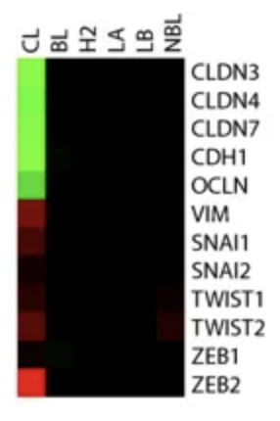
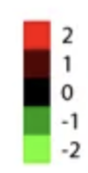
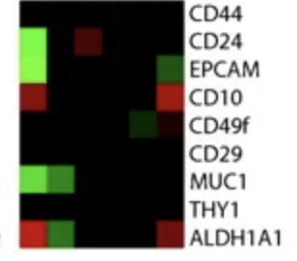
Claudin-Low related genes
Epithelial to Mesenchymal Transition (EMT) related genes
Stemness related genes

Slide 15
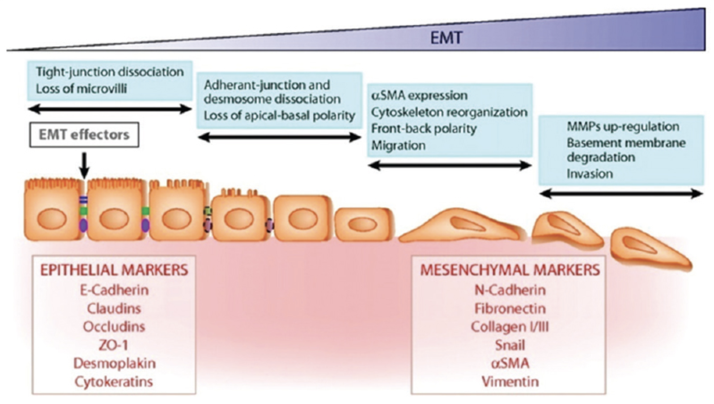

Slide 16
Signal Flow Analysis

Slide 17
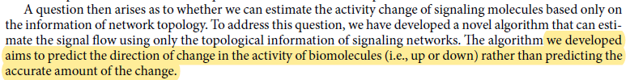
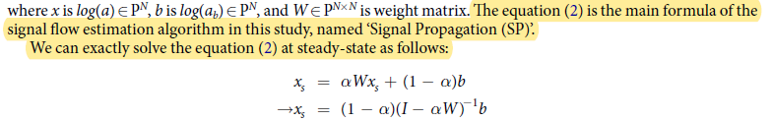
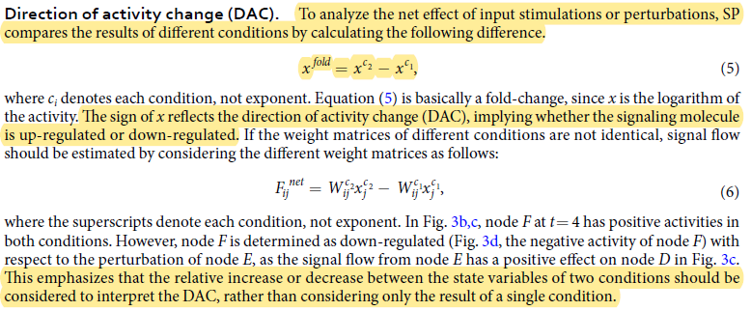
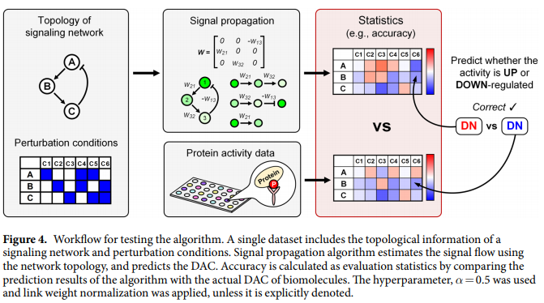
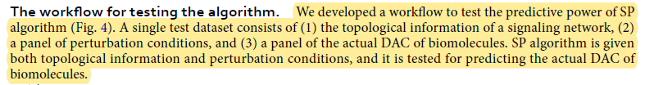
Key Excerpts from SFA paper
NOTE: their algorithm does not actually compute this, we compute it.

Slide 18
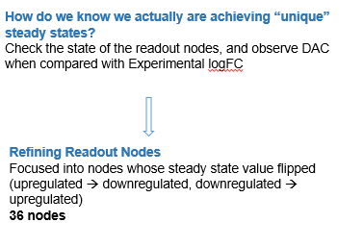
Back in the Winter
When deciding how to chose readout nodes:
Our quick way at the time (instead of computing all attractors)
We called these “strongly controlled readout nodes”

Slide 19
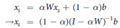
Today
The value provided after 1 run of the SFA code for each node is the log of the activity steady state as computed from the following equation:
Where α= hyperparameter (default=0.5)
b= basal activity of the node (our normalized expression values)
W= weight matrix (contains the weight of the edges, as determined by the sign of the edge, the outdegree of the source node, and indegree of the target node)
We chose readout nodes based on:
DAC between 231 vs 10A =experimental logFC 231vs10A (in direction, not magnitude)
Steady state value “flips” between 231 and 10A (+ in 231,- in 10A, vice versa)
Literature to see biological relevance

Slide 20
Today’s Question
How do we decide if a perturbation is successful?
Based on
We should observe that DAC of (231-perturbation) = DAC of (231-10A) for readout nodes

Slide 21
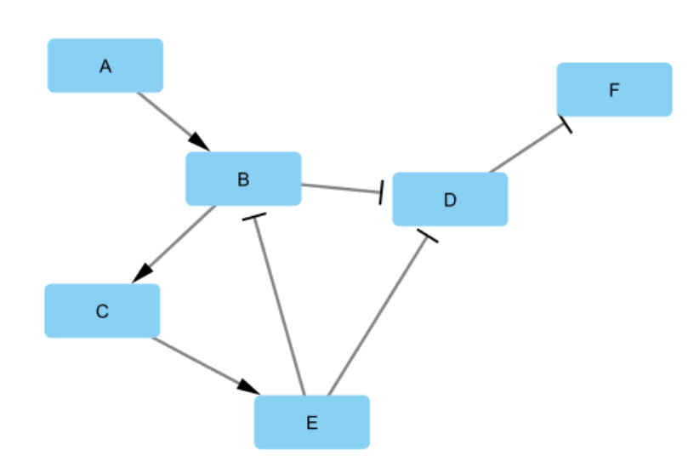
A very simple example
Consider the following network

Slide 22
A very simple example
Let the nodes of the network’s basal activity values in Initial State 1 be as follows:
b[data.n2i['A']] = 1
b[data.n2i['B']] = 0
b[data.n2i['C']] = 1
b[data.n2i['D']] = 0
b[data.n2i['E']] = 0
b[data.n2i['F']] = 1
Resulting in log steady state activity levels as produced by SFA of:
A: 0.5
B: 0.10944008
C: 0.53869291
D: -0.09469663
E: 0.26934646
F:0.54734832

Slide 23
A very simple example
Let the nodes of the network’s basal activity values in Initial State 2 be as follows:
b[data.n2i['A']] = 0
b[data.n2i['B']] = 1
b[data.n2i['C']] = 0
b[data.n2i['D']] = 1
b[data.n2i['E']] = 1
b[data.n2i['F']] = 0
Resulting in log steady state activity levels as produced by SFA of:
A: 0
B: 0.35912861
C: 0.12697114
D: 0.26934646
E: 0.56348557
F: -0.13467323

Slide 24
A very simple example
Based on topology:
There are 3 FVSes: [B],[C],[E]
There is 1 source node: A
On comparison of SFA results:
nodes | init1_attr_logss | init2_attr_logss | DAC: init1-init2
A | 0.5 | 0 | 0.5
B | 0.10944 | 0.359129 | -0.24969
C | 0.538693 | 0.126971 | 0.411722
D | -0.094697 | 0.269346 | -0.36404
E | 0.269346 | 0.563486 | -0.29414
F | 0.547348 | -0.13467 | 0.682022
Readout nodes would be: D, F

Slide 25
A very simple example
Next, we run perturbations on FVS nodes, source node, and 1 FC example (FC=A,B)
Table 1: log steady state values produced by SFA for initial state1, initial state2, and perturbations
(color coding to be explained further)
node | attr_1 | attr_2 | perturb1 (B=-1) | perturb2(B=1) | perturb3 (C=-1) | perturb4 (E=-1) | perturb5 (E=1) | perturb6 (A=-1) | Perturb7 (A=-1, B=-1)
D | -0.0947 | 0.26934646 | 0.0461747 | -0.23556803 | -0.00491448 | -0.00491448 | -0.18447879 | 0.004914 | 0.14578587
F | 0.547348 | -0.13467323 | 0.47691262 | 0.61778401 | 0.50245724 | 0.50245724 | 0.59223939 | 0.497543 | 0.42710706
If we use the log steady state values as the indicator of a successful perturbation, we are only able to flip the sign of D

Slide 26
A very simple example
Table 1: log steady state values produced by SFA for initial state1, initial state2, and perturbations
node | attr_1 | attr_2 | perturb1 (B=-1) | perturb2(B=1) | perturb3 (C=-1) | perturb4 (E=-1) | perturb5 (E=1) | perturb6 (A=-1) | Perturb7 (A=-1, B=-1)
D | -0.0947 | 0.26934646 | 0.0461747 | -0.23556803 | -0.00491448 | -0.00491448 | -0.18447879 | 0.004914 | 0.14578587
F | 0.547348 | -0.13467323 | 0.47691262 | 0.61778401 | 0.50245724 | 0.50245724 | 0.59223939 | 0.497543 | 0.42710706
Table 2: DAC between initial state1-initialstat2 and initialstate1-perturbations
node | DAC_attr1-attr2 | DACattr-perturb1 | DACattr-perturb2 | DACattr-perturb3 | DACattr-perturb4 | DACattr-perturb5 | DACattr-perturb6 | DACattr-perturb7
D | -0.36404 | -0.14087 | 0.140871 | -0.08978 | -0.08979 | 0.089779 | -0.09961 | -0.24049
F | 0.682022 | 0.070436 | -0.07044 | 0.044891 | 0.044891 | -0.04489 | 0.049805 | 0.120241
However, if we observe the DAC for attr1-perturbation and compare it to the DAC of attr1-attr2, we have successful perturbations of both D and F (perturb1,3,4,6,7 –green and yellow)
We can note, that perturbations 1,6,7 are “strong” perturbations, meaning they additionally flip the sign of node D (green)

Slide 27
Results for 231vs10A
Table3: FC set nodes, basal values at 231, and perturbation basal values
Table 4: log steady state and DAC values for readout nodes for 231 attractor, 10A attractor, and perturbation 154
FC set | 231_basal | perturbation
EGFR | 1 | -1
FOXM1 | 1 | 1
HDAC3 | 0 | -1
MAPK1 | 0 | -1
MAPK6 | 0 | -1
PRPF4 | 1 | 1
RELA | 1 | 1
ZBTB17 | 0 | 1
readout node | 231_attr_logss | 10A_attr_logss | DAC:231attr-10Aattr | perturbation_logssvalue | DAC:231-perturbation
CCNG2 | -0.023258 | 0.449012 | -0.47227 | -0.022053855 | -0.0012
CDC20 | 0.527669 | -0.062051 | 0.58972 | 0.461965111 | 0.0657
FYN | 0.503292 | -0.031171 | 0.534463 | 0.492715089 | 0.01058
GSK3B | -0.072169 | 0.402316 | -0.474485 | 0.025515518 | -0.09768
HUWE1 | 0.503292 | -0.031171 | 0.534463 | 0.492715089 | 0.01058
MAPK13 | 0.504577 | -0.009799 | 0.514376 | 0.497901685 | 0.00668
SNAI1 | 0.584197 | 0.166042 | 0.418155 | 0.462664685 | 0.12153
STAT3 | 0.712497 | 0.225066 | 0.487431 | 0.494473725 | 0.21802
initial condition (perturbation 154) flipped one sign, but gave the correct DAC for all 8 readout nodes
Additionally, for all 256 potential perturbations, only 1 readout node’s sign was ever flipped,
but 6 perturbations could change the DAC for all 8 readout nodes

Slide 28
Conclusions
Based on the SFA paper and our observations, the best way to interpret a successful perturbation is by observing if the DAC of initial_condition-perturbation is in the same direction as the DAC of 231 to 10A, or whatever you are comparing
Why are we saying this instead of just looking at the sign flipping:
Now that we have computed all of the in silico perturbations we can note:
We focused on the sign flipping to cut down the number of readout nodes (otherwise it would be the entire network as a possibility)
In the case of 231 to 10A, we will never have successful perturbations if our measure is flipping the sign
In the SFA paper, they measure success as DAC direction matching, and if we do so for 231 to 10A, we have 6 successful perturbations.

Slide 29
Feedback Vertex Set Control

Slide 30
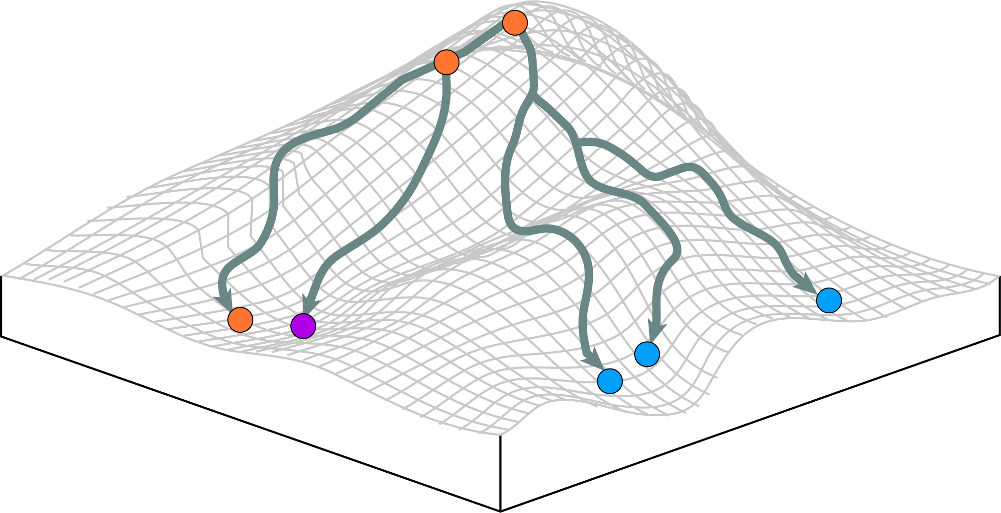
Control of Systems
A system is controllable if it can be driven from any initial state to any desired final state in finite time
Initial state
Final (steady state) attractors

Slide 31
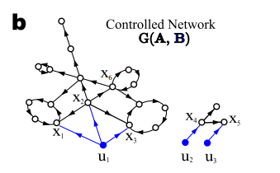
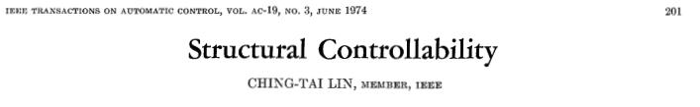
Structural Control Theory – Lin 1973
Model the system as A and B
A= nodes
B= inputs (blue)
Theory: The system (A,B) is structurally controllable if it is possible to fix the free parameters in A,B to certain values so that the obtained system (A,B) is controllable in the usual sense (math proof)
i. the directed graph (digraph) G(A,B) contains no inaccessible nodes ii. The digraph G(A,B) contains no dilation

Slide 32
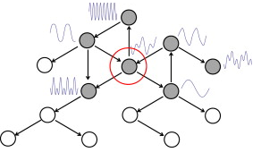
Mochizuki 2013- Feedback Vector Set
Any FVS of a regulatory network is a set of determining nodes of the dynamics on the network. Observation of the FVS is necessary to faithfully reconstruct all trajectories in the global attractor.
A FVS is a subset of vertices in a directed graph, such that the removal of the set leaves the graph without directed cycles

Slide 33
Zanudo 2017- Feedback Vector Set Control

Slide 34
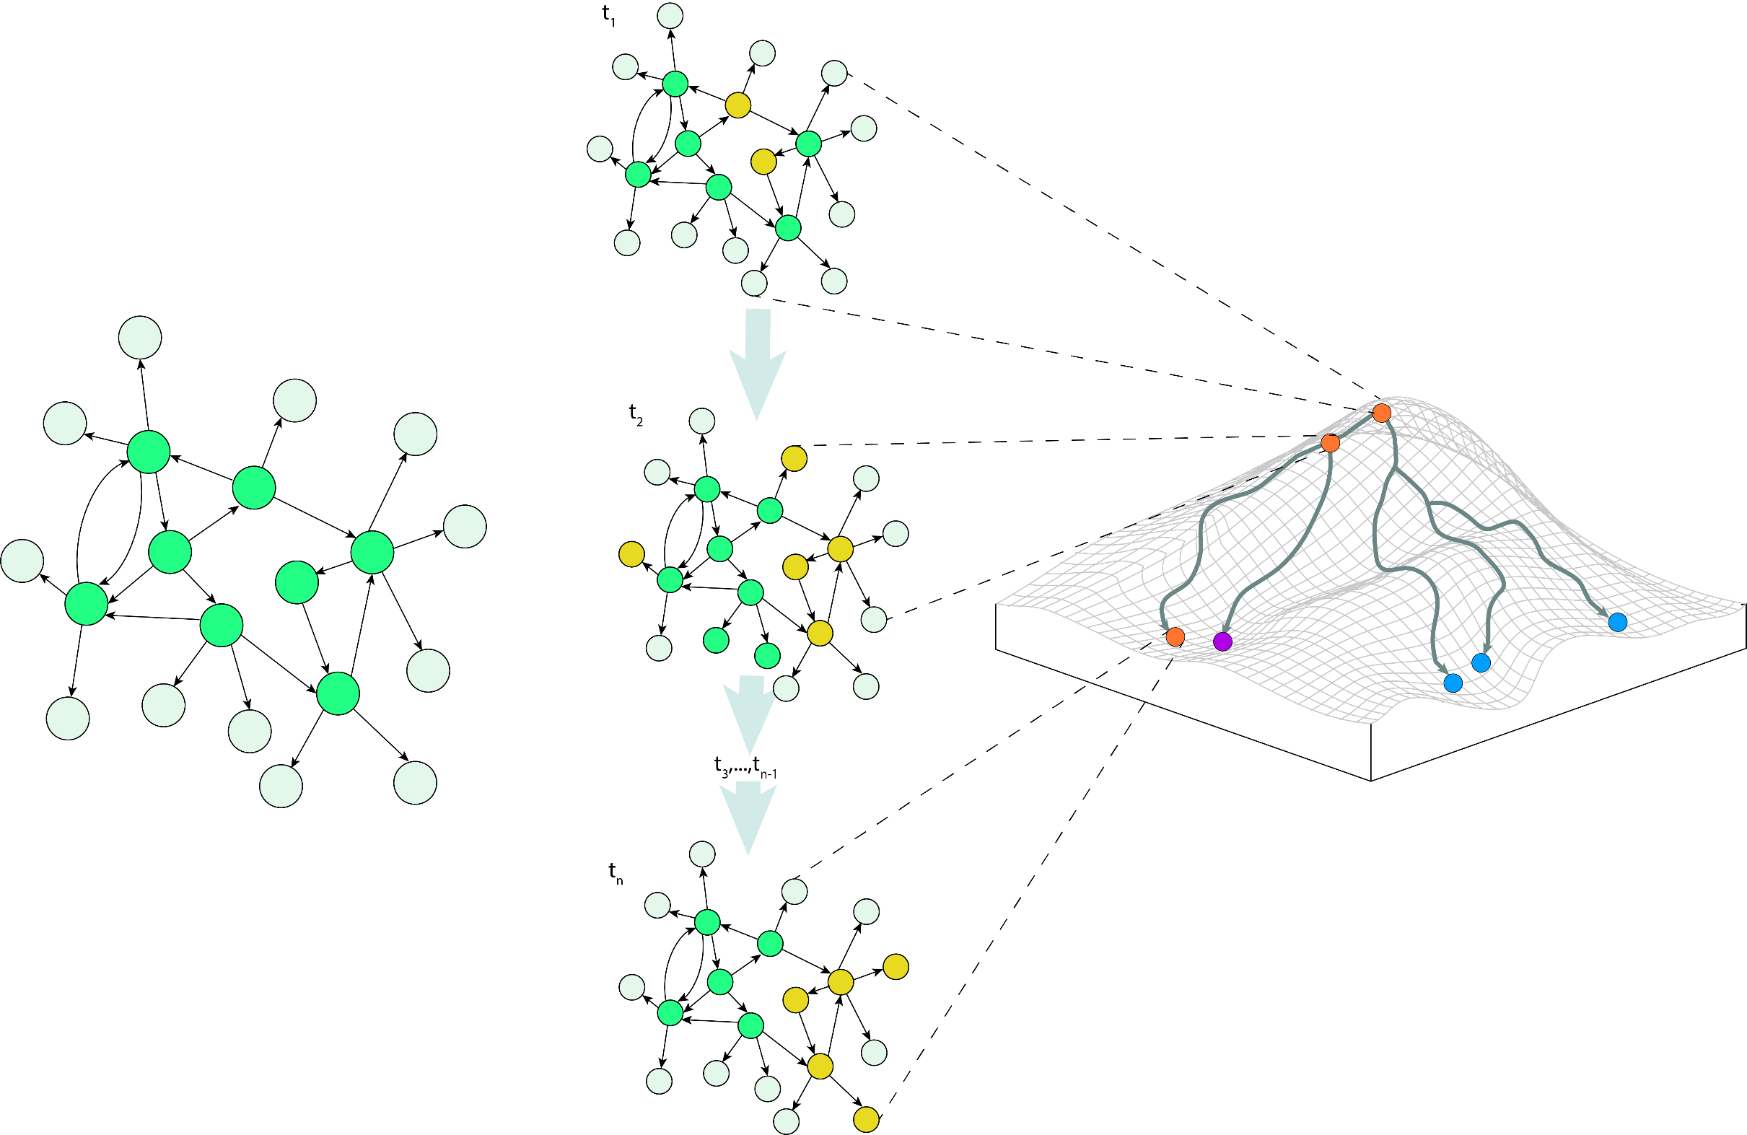
In our Context:
The FC set is capable of steering our network to any steady state attractor (phenotype)- could be hundreds to thousands.
We are interested in determining the FC set that steers our network towards the sensitive phenotype.
Sensitive phenotype
Resistant phenotype
Vehicle

